Slide 1
CONDUCTING A JURY TRIAL DURING A PANDEMIC
Jury Bailiffs
Kosciusko County

Slide 2
PERSONAL PROTECTIVE EQUIPMENT
PPE
The Supreme Court provided guidelines and authority to each Court to determine the level of personal protective equipment (“PPE”) that is necessary for the public, attorneys, press, witnesses, and jurors. Kosciusko County Courts will determine how their PPE Order will be enforced prior to entering this Order.
Masks are primarily for the protection of those around you working by trapping your respiratory droplets that may transmit the virus to others. Masks also serve as a physical reminder not to touch your face with your hands. Face masks will be provided. DO NOT BRING YOUR OWN.
Gloves will be available if and when shown to be needed.
Face Masks
Gloves

Slide 3
JURY SERVICE – CIVIC RESPONSIBILITY AND THE PATRIOTIC DUTY OF EVERY AMERICAN CITIZEN
JURY SERVICE

Slide 4
HEALTH SCREENING/TEMPERATURE CHECK SOCIAL DISTANCING/SANITIZING
COVID-19 SAFETY
Health Screening/Temperature Check
Social Distancing/Sanitizing
Each jury member should have received and must return the additional juror questionnaire regarding COVID-19 that was provided to you with your jury summons.
Upon arrival for jury service, your temperature will be taken through a non-invasive, no-contact digital thermometer.
You will be asked to complete an additional health screening if one has not been provided OR needs updated.
.
The Courts have taken multiple steps to provide social distancing where possible as well as reasonable sanitization of all areas.
You will notice chairs spaced apart as well as taped markers to comply with social distancing guidelines.
The Courtroom will be deep cleaned each evening.
Hand sanitizer will be provided in multiple locations.
All common areas where the jurors will be located will be sanitized regularly.

Slide 5
20XX

Slide 6
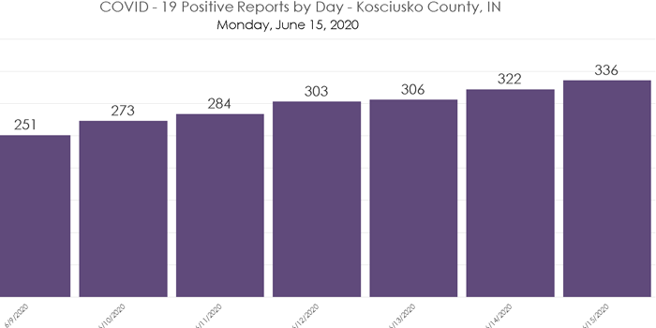
COVID-19 CHART
COVID-19 CHART
COVID-19 CHART – Kosciusko County
COVID-19 CHART
Graph provided by the Kosciusko County Health Department

Slide 7
OVERVIEW SLIDE
Conducting Jury Trials During a Pandemic
Personal Protective Equipment
Jury Duty – Civic Responsibility and the Patriotic Duty of Every American Citizen
.
Face masks/Gloves
SOCIAL DISTANCING/SANITIZING/ HEALTH SCREENING/TEMPERATURE
Photograph Jury Assembly Room
COVID-19 chart
COVID-19 Safety Guidelines
Photo
Kosciusko County Health Department.

Slide 8
THANK YOU!
Kosciusko County
The Court takes public health and safety seriously and has implemented aggressive safeguards and policies to help prevent the spread of COVID-19 and to prevent the risk of infection for jurors and other court users, including our staff.
Jury Bailiffs
Kosciusko County

